Slide 1
LRC Skills Lab Orientation & Safety
Colette Townsend-Chambers, MSN,RN
Director, Learning Resource Center
UNC Charlotte
August 2014
ctowns12@uncc.edu

Slide 2
Purpose and Philosophy
The nursing clinical lab is an environment conducive to the advancement of your nursing education.
Here you will develop skills, practice and be evaluated on those skills through the use of simulated learning experiences with models, task or high fidelity manikins, peers, and when appropriate; live models. This enables you to practice in a safe environment to build confidence and dexterity.
The skills lab is an extension of your clinical practicum and should be respected and treated as a clinical environment.

Slide 3
General Information
All labs are to remain locked during lunch or breaks unless occupied by faculty or graduate assistants.
Some courses require mandatory lab time, however Open Lab hours are posted on the bulletin board outside the labs each semester.
All should be beds returned to the lowest position/top side rails up, and all equipment turned off and returned to it’s proper place.

Slide 4
General Information (cont.)
Students are expected to come prepared by having watched the appropriate skills video and having read the scheduled lab objectives. Students shall practice and demonstrate only those skills for which they have had prior instruction and practice safe and appropriate techniques while learning and practicing skills in the lab.
GA’s (graduate assistants) are here to reinforce materials you have been taught by your instructor. Get clarification on specific questions from your instructor.

Slide 5
Lab Expectations
Food, Smoking, Gum chewing and Beverages is not permitted in any of the labs. (Please utilize frequent breaks well.)
Wear student ID & uniform or appropriate attire.
Cell phones should be off or on vibrate.
Sign in and out each time you enter the lab. You will be credited only for the time you are actively practicing.
Manikins should be touched only with clean hands and gloves. Using only paper tape on them, and no ink pens or markers near manikins. - They stain!
Manikins may only be moved by or with the permission and assistance of lab personnel.
Human patients should remove their shoes when in bed.
Sharps, lab resources and books must remain in the lab.
All organic materials used for suturing/dissection should be properly disposed of daily.

Slide 6
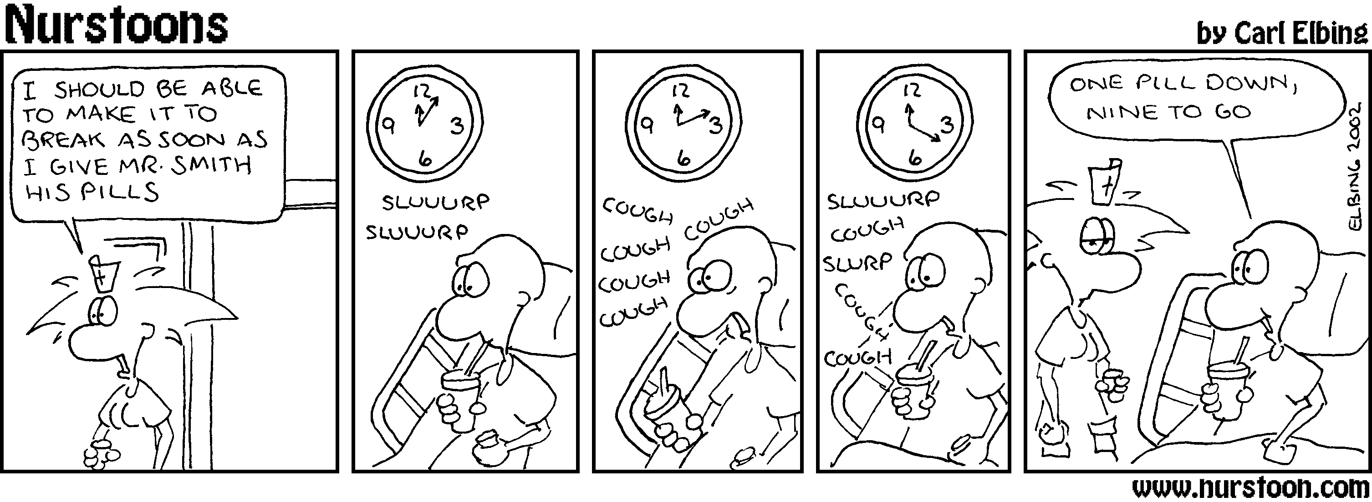
Medications
Practice meds, IV fluids and placebos are to be used for demonstration, not actual use or ingestion.
All medications must remain in med drawers until used and returned after simulation demonstration.
All meds or liquids mixed must be labeled with content name, date and preparer’s initials.

Slide 7
Sharps and Needle Safety
When breaking glass ampules, use the plastic ampule covers provided, slide over ampule and break away from the body/face.
Needles are never to be recapped or left laying on tables or surfaces anywhere in the lab.
As a precaution, use the sharps container closest to you and when in close vicinity with others, LOOK- before moving towards sharps box, calling out “ SHARPS”, before reaching to dispose of sharp/ampule/needle. Be certain that you are seen and heard before reaching to dispose of your sharp.

Slide 8
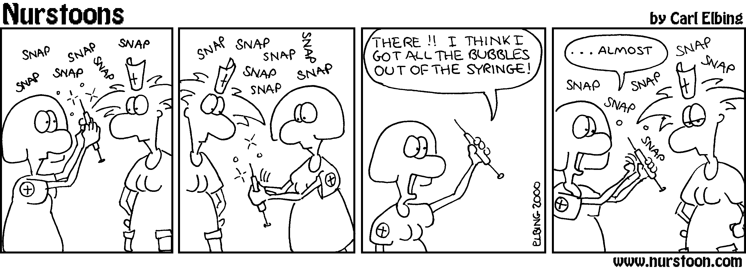
Q: What’s the trick to getting all the air out? Discuss this with your peers and instructor

Slide 9
Incidents/Emergencies/Resources
Report all incidents to your instructor and or Lab Director immediately.
Please refer to the LRC Manual, CHHS SON Student Handbook and the UNCC Environmental Health and Safety web page, for further details https://safety.uncc.edu/ (704)687-1111
Students and faculty should be aware of nearest exit in the event you need to evacuate during fire, etc.
When in doubt, contact campus securityhttp://police.uncc.edu/ (704)687-2200

Slide 10
What do you need to do now?
Be certain you have obtained a copy of the UNCC School of Nursing Latex Response Plan, & the Nursing Skills Lab Orientation Quiz/Agreement and submit a completed and signed copy to your instructor.
Click on this link to access the form or check your instructor's Moodle page.
http://nursing.uncc.edu/student-resources/learning-resource-center
Bring completed and signed hardcopy to skills class on the first day.

Slide 11
YOUR SAFETY
Is our number one concern!
Thank you for your cooperation☺

